Slide 1
TITANIC
ANALYSIS OF DATA
Project By
Sweety Priya Gupta
Project Mentor :
Prof. Arnab Chakraborty
Globsyn Skills

Slide 2
CONTENTS
What and why is Machine learning?
ML Applications
Project Objective
Titanic
Usage of Algorithms
Random Forest Algorithm
Logistic Regression Algorithm
Works Cited
Conclusion

Slide 3
What is Machine Learning?
It is concerned with computer programs that automatically improves their performance through experience.
Why?
Develop systems that can automatically adapt and customize themselves to individual users.
Personalize news or mail filters.
Discover new knowledge from large databases(DATA MINING).
Market basket analysis .
Ability to mimic human and replace certain monotonous tasks – which requires some intelligence.
Like recognizing handwritten characters.
Increasing computational power.
Flood of available data (large amount of data is produced per day.)

Slide 4
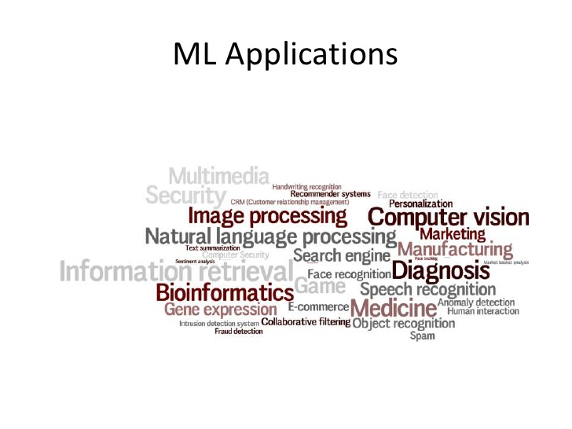

Slide 5
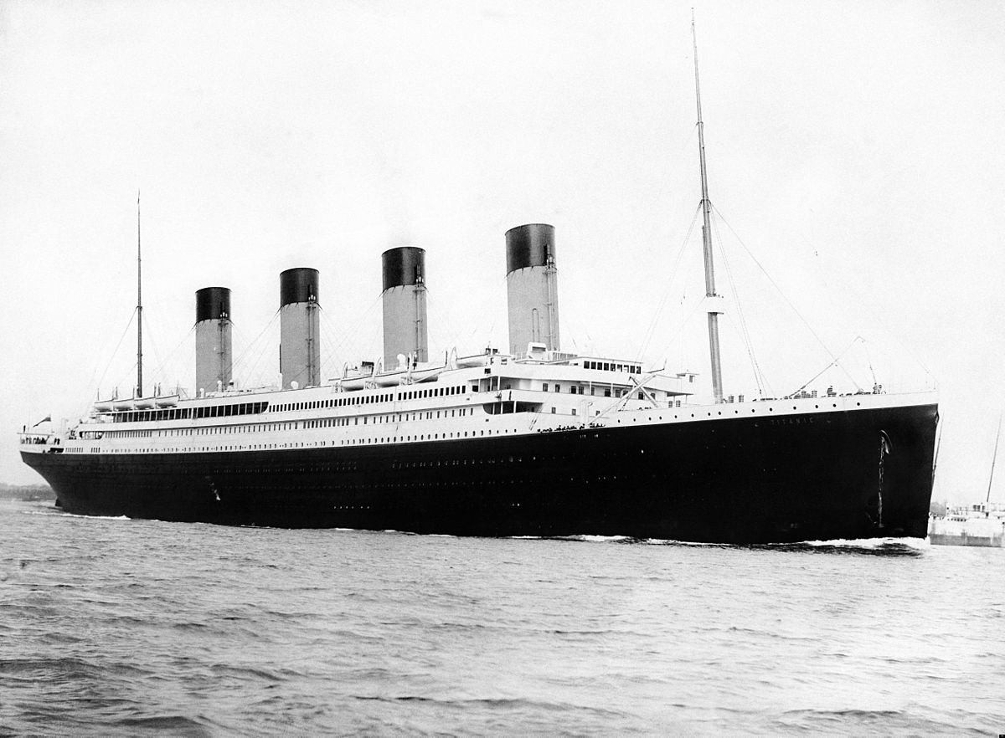
Overview of titanic
In 1912, the ship RMS TITANIC struck an iceberg on its maiden voyage.
It got sank resulting in the deaths of most of its passengers and crew.
On that day ,it was seen that people who are rich got preference for survival, and after that women and children’s got preference.

Slide 6
Project Objective
To develop a machine learning model which predicts:
Survived passenger on the basis of age, sex and passenger class.
Accuracy of the machine learning model.

Slide 7
Titanic
Attribute description:
VARIABLE DESCRIPTIONS:
survived Survival
(0=No; 1=Yes)
pclass passenger class
(1=1st,2=2nd,3=3rd)
name Name
sex Sex
age Age
embarked port of embarkation
(C = Cherbourg, Q = Queenstown, S = Southampton)
home.dest Home of the passengers(city).

Slide 8
Usage of Algorithms
Random Forest algorithm.
Logistic Regression algorithm.
“ classification is a data mining technique used to predict group membership for data instances.”

Slide 9
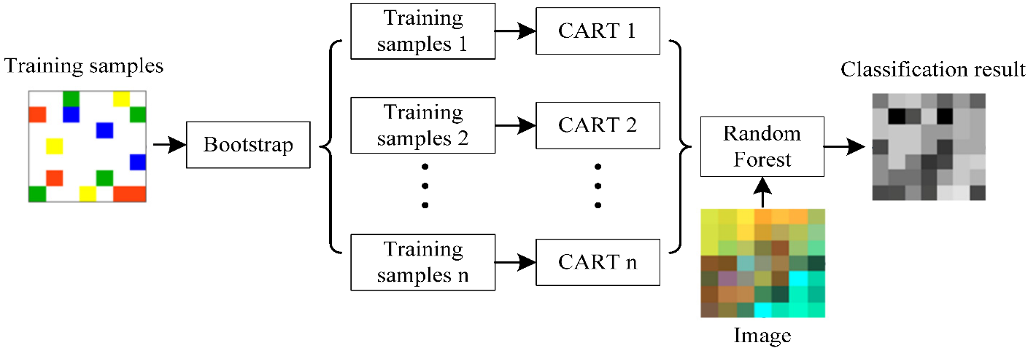
Random Forest Algorithm
Random Forest(RF) is a powerful classification tool.
Can be used for classification and regression.
Accuracy and variable importance information is provided with the results.
This model is like a gumball guesses really awful but once they are averaged they can be the powerful predictive tool.

Slide 10
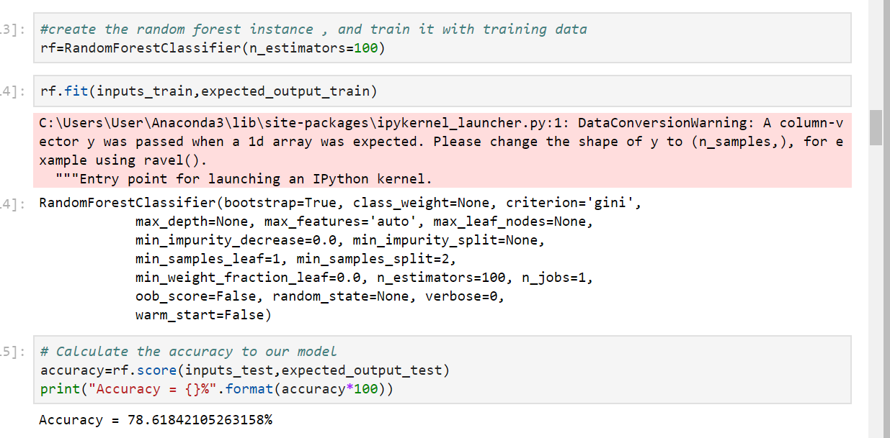
Random forest algorithm generates many extremely simple models to explain the variance observed in random subsection of our data.
In our project random forest didn’t stumble on the true structure of the data.
We use RandomForestClassifier in our project, and trained our model with the input training set( pclass, age, sex) and expected output (survived people).
We got the accuracy of 78% of our model.

Slide 11
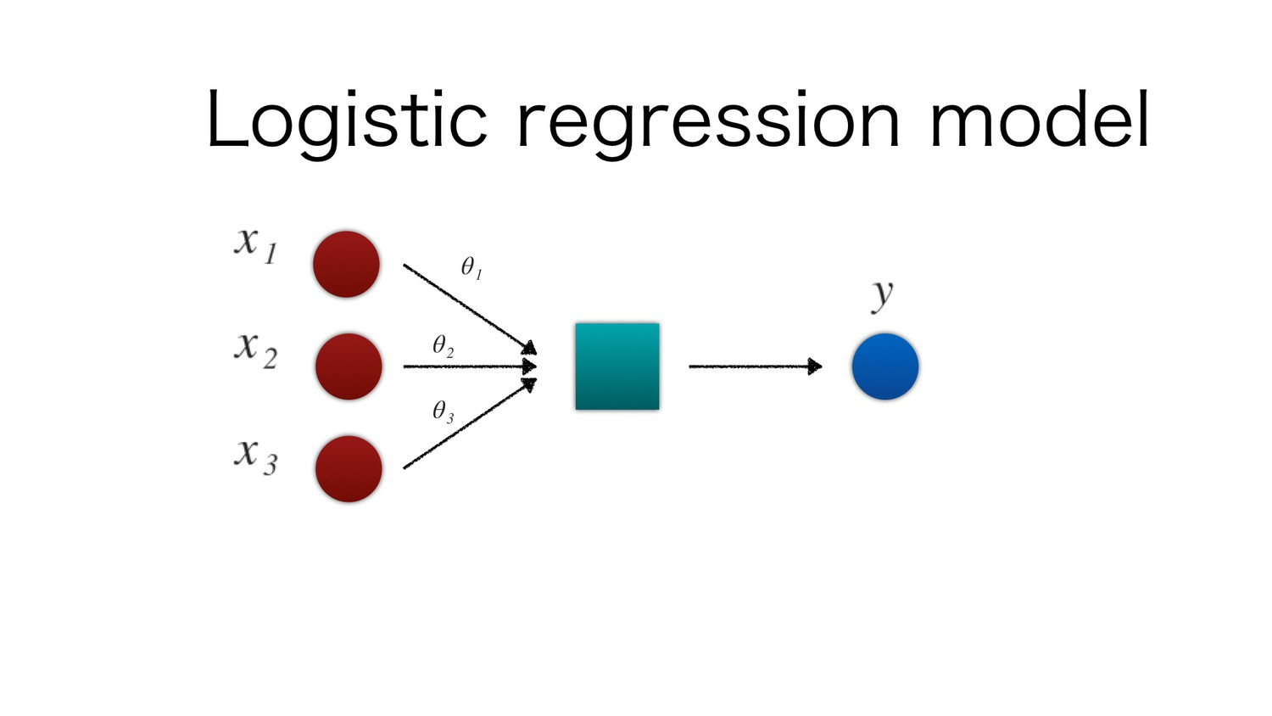
Logistic Regression algorithm:
Logistic regression or logit regression is a type of regression analysis used for predicting the outcome of a categorical dependent variable based on one or more predictor variables.
Logistic regression is used to refer to the problem in which the dependent variable is binary.

Slide 12
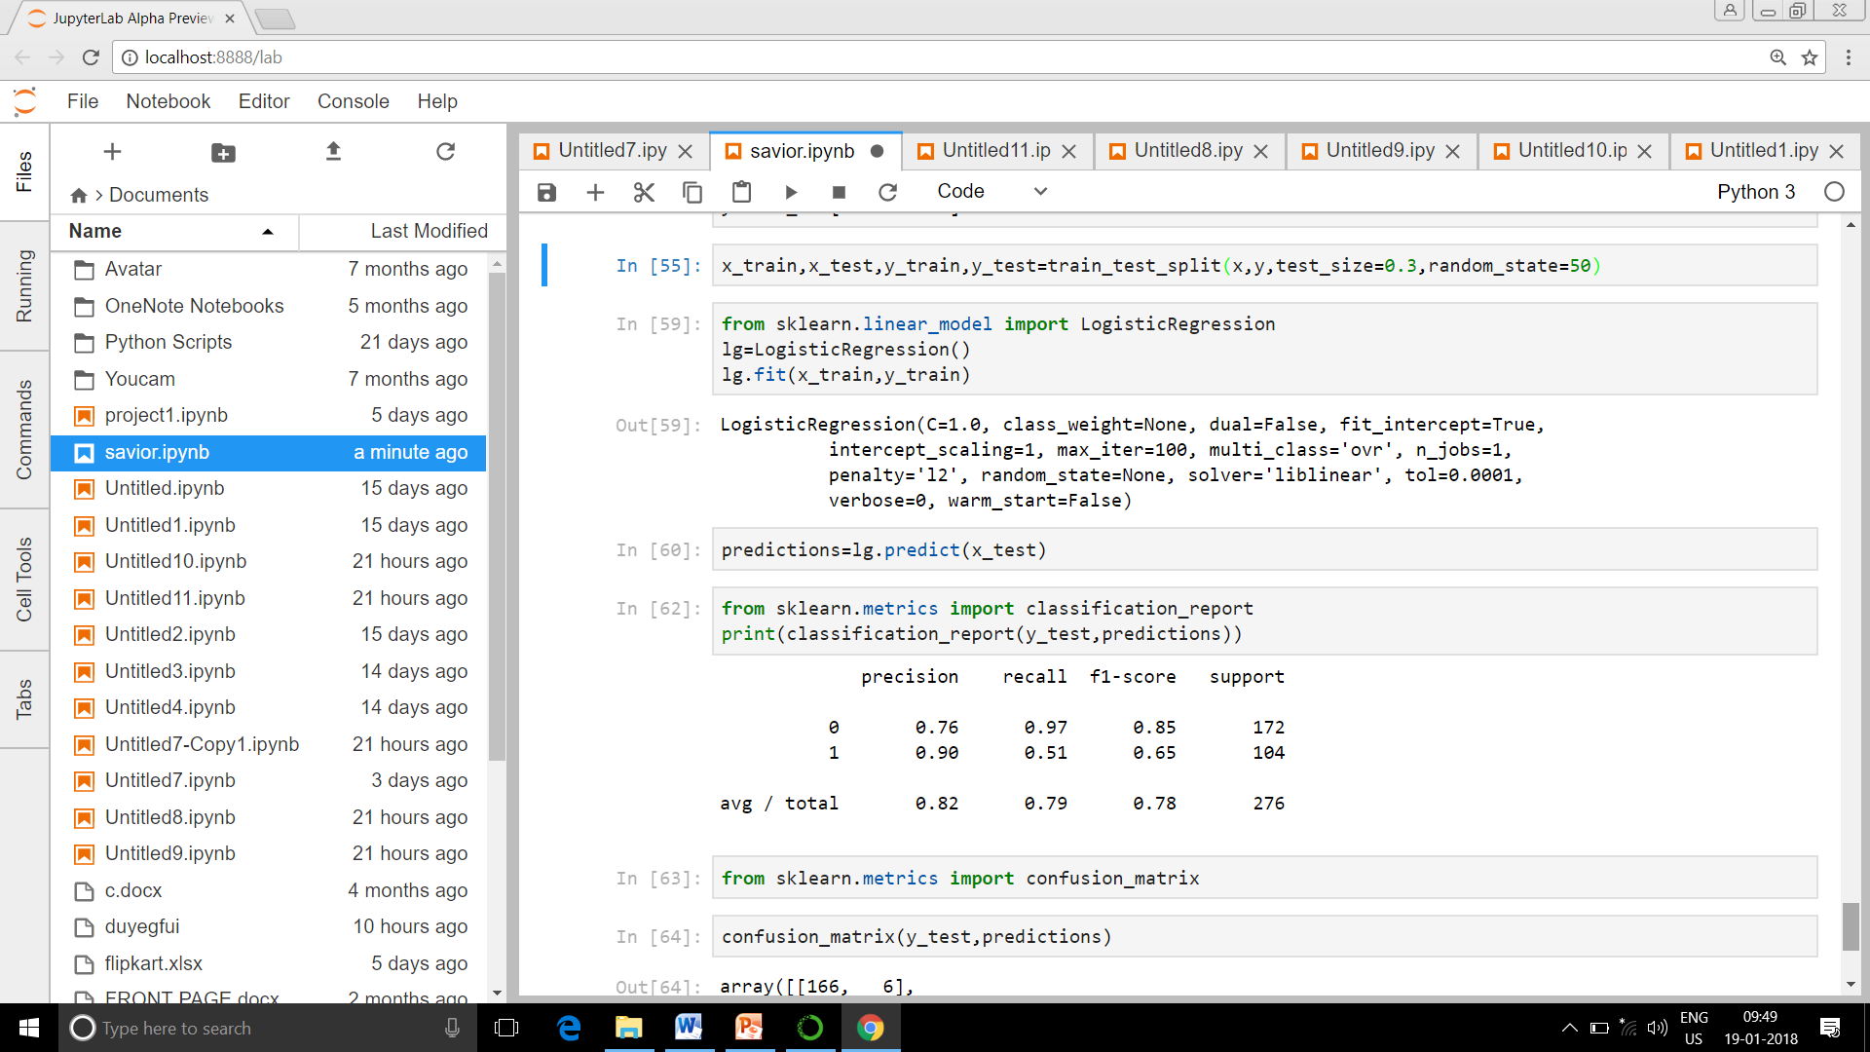
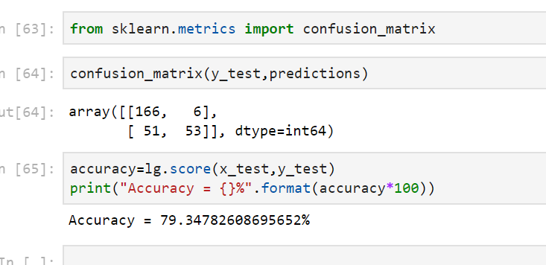
It measures the relationship between a categorical dependent variable and one or more independent variable , which are usually continuous by using probability scores and predicted values of dependent variables.
Screenshot of code using Logistic Regression
Using LogisticRegression the accuracy of the model came 79%.

Slide 13
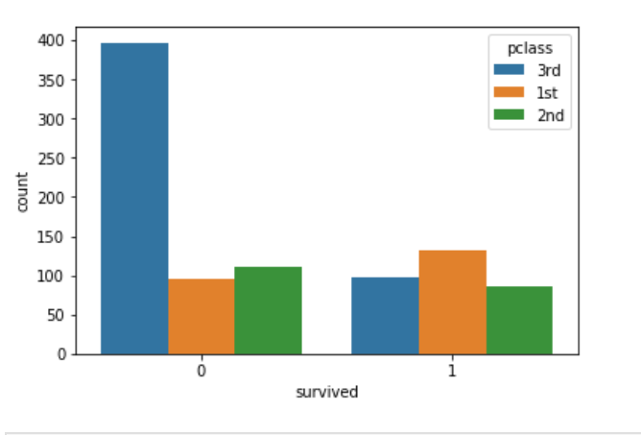
Graph showing number of people survived on the basis of passenger class and here(0 represents non survivors whereas 1 represents survivors).

Slide 14
Works Cited
Scikit-learn.org
Machinelearningmastery.com
http://scikit-learn.org/stable /modules/generated/sklearn.metrics.make-scorer.html
https://scikit-learn.org/stable/modules/generated/sklearn.ensemble.RandomForestClassifier.html
https://blog.socialcops.com/engineering/machine-learning-python/

Slide 15
Conclusion
A large dataset can be analysed using simple classification algorithm.
Using simple classification algorithm like Random Forest we can get approximately accurate predictions of survived people.
We can create model upto 80% accuracy using Random Forest algorithm and Logistic Regression algorithm to predict the survival of people.

Slide 16
Thank you

